Slide 1
COLT
Collective Organization of Local Talent

Slide 2
Introduction
Since Coronavirus lockdown made people to stay at their homes and do their jobs online, we made this android app to help people to find the product that they need by searching it online.
By using this application, you can create your own account and run your own business. You can also post your products and services so that people can find it.
This application is for people who want to sell their services and products while maintaining social distancing. You can buy and sell products and services without intervention of a third party.

Slide 3
Problem Statement
1)A single platform for local businesses:
Since COVID began, unemployment has reached its peak and therefore many people have opened their startups / local businesses. Build an App / website that allows these individuals / groups of people to connect with consumers to display products and also employment details.

Slide 4
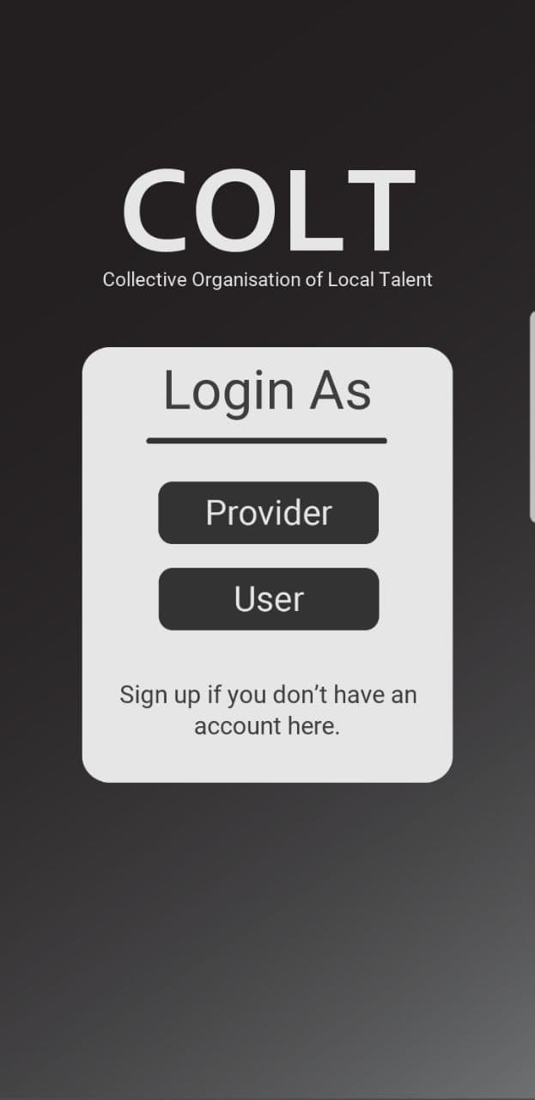
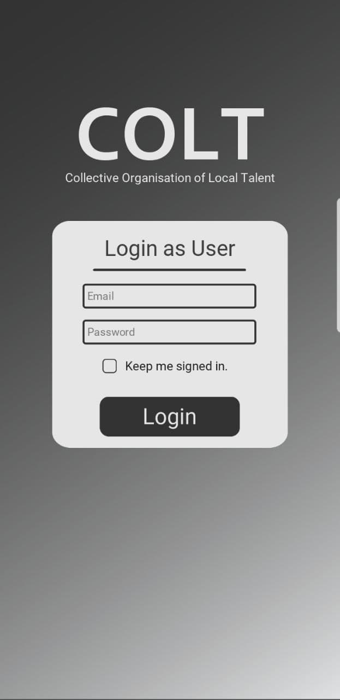
About the project:

Slide 5
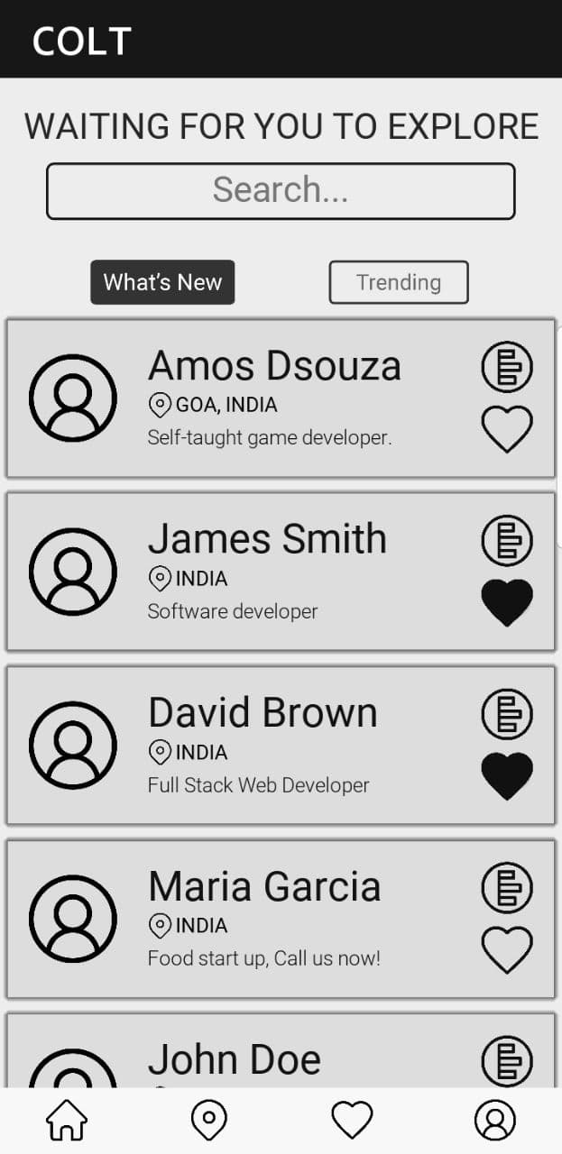
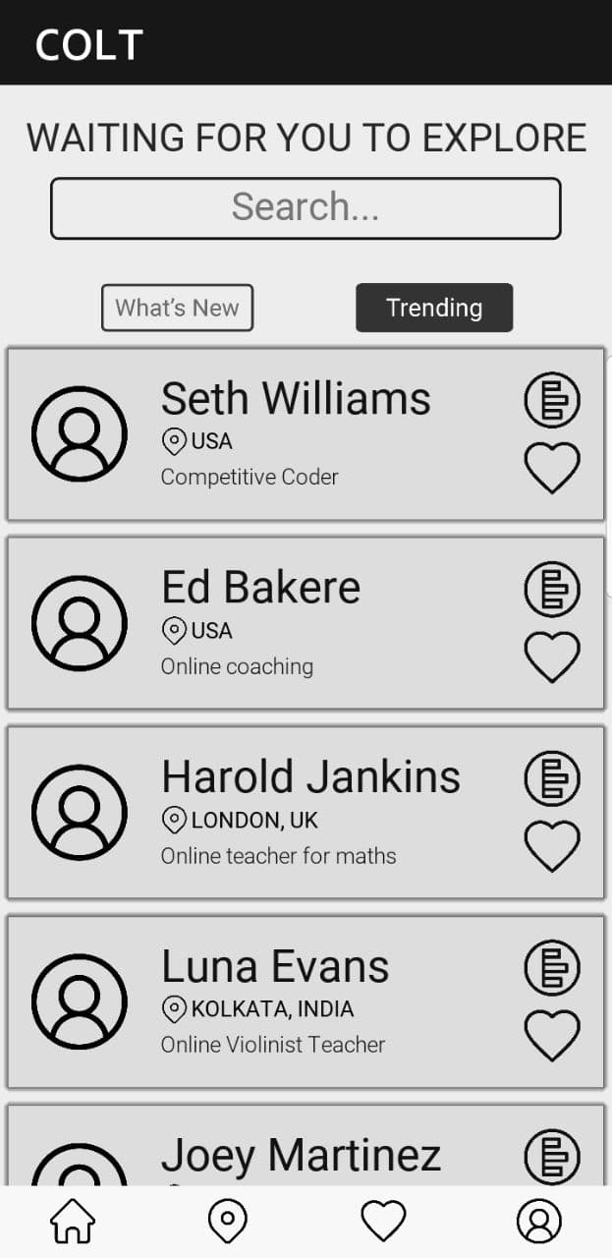
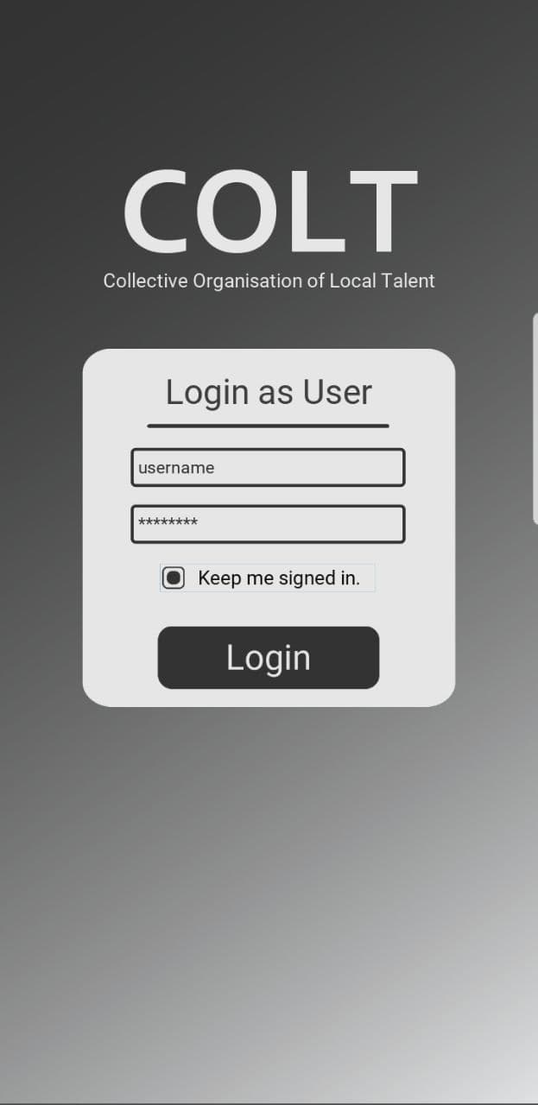

Slide 6
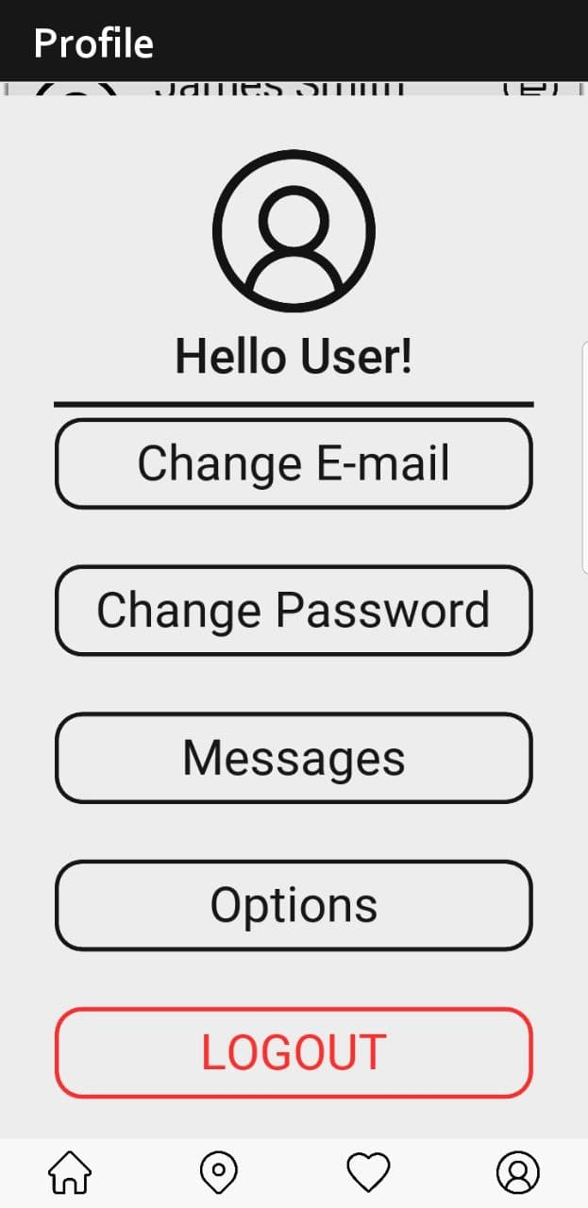
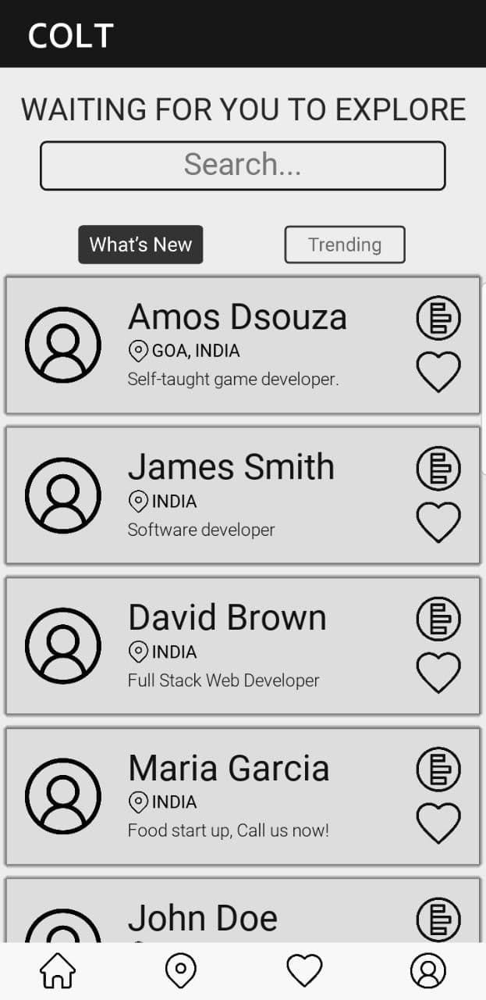
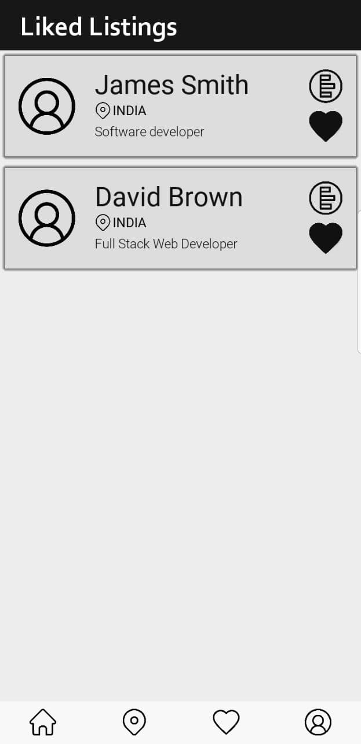

Slide 7
Future scope:
This application lacks some features that we want to include in the future. We would like to add the following features:
Chatting
Search sorting
Online payment
Supporting different local languages
Finding jobs around us
Integration with Firebase

Slide 8
COLT
Collective Organization of Local Talent

